Slide 1
Introduction to Programming
Introduction to Python for Security

Slide 2
Course Path
Introduction to Python for Security
Introduction to Programming
Data Types & Conditions
Loops
File System & Error Handling
Python for Security
Network Communication
Functions

Slide 3
Objectives
Introduction to Programming
Python is a dynamic programming language developed for network manipulations and computing operations.
This lesson is an introduction to the Python programming language and development environment.
Introduction to Programming
Python Installation
Python IDE
Python Environment & PyCharm
Basic Syntax
Notes:
Explain the main goals of this lesson, including what computer programming is, why Python should be installed on a PC and how, what the PyCharm environment is, and understanding basic syntax principles.

Slide 4
Introduction to Programming
Introduction to Programming

Slide 5
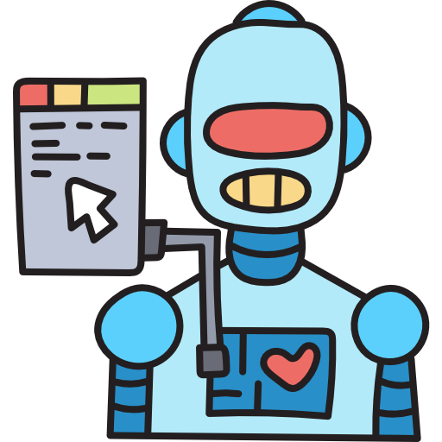
Computer Instructions
Introduction to Programming
A computer doesn’t understand code like humans do.
It understands basic instructions called machine code.
A computer’s CPU handles its instructions and calculations.
Machine code is a language that enables fast execution. It can be regarded as the lowest level source code.
Notes:
Explain how the CPU handles instructions and understands the code.
Explain that every source code that was ever written was ultimately converted to machine code for execution.
Mention that machine code is a numerical language that enables fast execution.
It can be regarded as the lowest level source code.

Slide 6

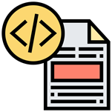
What Is Programming?
Introduction to Programming
Programs
Programs are lists of instructions the computer performs in sequential order. They typically include mathematical operations.
Source Code
A program written in a high-level programming language
A programming language includes a set of instructions that yield various types of results.
Notes:
Explain what a programming language is and the concept of instructing the CPU to execute the code.
You can compare programs to recipes, which require ingredients, quantities, steps, order, and testing.

Slide 7
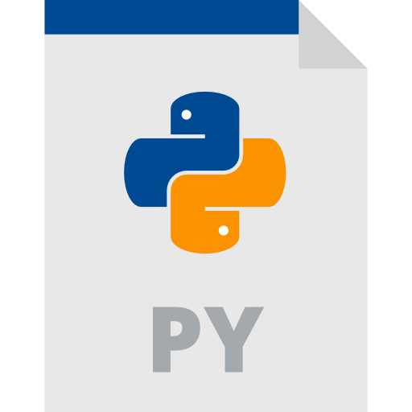
What Is Python?
Introduction to Programming
A high-level programming language
Easy to deploy and learn
Python’s design emphasizes code readability.
Python is not meant for low-level programming.
Notes:
Briefly explain the following:
Python as a high-level programming language
Why it is easier to learn than other languages
The advantage of readable code
Python’s efficient, high-level data structure
Python’s simple but effective approach to object-oriented programming
Python includes structures that enable the expression of complex programs in concise and clear ways.
Explain Python’s syntax and its use of indentation to define blocks of code.

Slide 8
Python vs. Other Languages
Introduction to Programming
Python |  | C# |  | Java
Easy to learn |  | Hard to learn |  | Hard to learn
Works in any environment |  | Works in specific environments |  | Works in any environment
Many libraries |  | .NET libraries |  | Few libraries
Large community |  | Large community |  | Large community
Syntax is easy to learn |  | Syntax is difficult to learn |  | Syntax is difficult to learn
Many frameworks |  | .NET framework |  | Many frameworks
Notes:
Describe the following:
Python’s versatility
How easy it is to learn
The fact that it can work in any environment
Python’s large set of tools that are also commonly used by hackers
Tell learners that for these reasons and more, Python is suited for cybersecurity scripting.

Slide 9
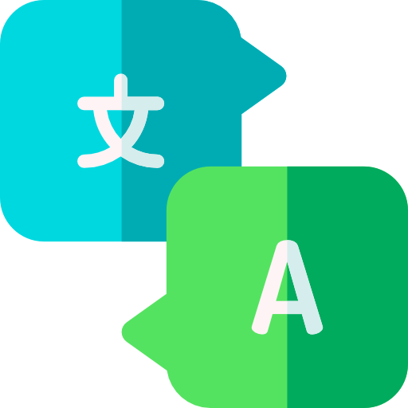
Python Interpreter
Introduction to Programming
Python is an interpreter language.
Reads instructions from top to bottom and left to right, with exceptions
Performs instruction validation
Results are returned per instruction, in sequential order.
The interpreter can be run from within CLI using the py command or installed in the IDE.
Notes:
Explain the following:
How interpreter language works, in contrast with compiled languages, ​​such as C++
Python is known as an interpreter language, which is a program that reads and executes code.
An interpreter can be run from CLI using the py command or installed in the IDE.
There are multiple implementations of Python.

Slide 10
Compiler vs. Interpreter
Introduction to Programming
Compiler |  | Interpreter
It takes more time to compile; however, the code execution is faster. |  | Execution takes more time, and each instruction must be compiled in real time.
The code is compiled for a specific operating system. |  | Code can be executed in any environment that includes the interpreter.
The source code is typically unavailable, and the compiled data can be read. |  | The source code is available and readable.
Once the binary is compiled, the source code is no longer needed. |  | The code is needed each time the program is executed.
Notes:
Explain the main differences between a compiler and an interpreter.
For example, compiling takes more time to process the code.
After compiling code, the compiler will only run in the designated environment, while an interpreter can run in any environment.
In addition, after compiling code, the code can no longer be read as plain code, while interpreter languages can be read as source code.

Slide 11
Python 2 vs. Python 3
Introduction to Programming
Python 2 |  | Python 3
Python 2 code is considered legacy code. |  | Python 3 replaced Python2 at the beginning of 2020.
Many older libraries built for Python 2 are not forward-compatible. |  | Most new libraries are being developed strictly for use with Python 3.
Strings are stored as ASCII characters by default. |  | Strings are stored as Unicode characters by default.
Calculations are rounded to the nearest whole number. |  | Calculations are not automatically rounded.
Print “Hello” |  | Print(“Hello”)
Notes:
Explain the differences between the last two versions of Python (2 and 3), such as syntax, how strings are stored, and calculation processes.
Discuss the following:
Python 2 - rounded calculation (5/2 will return 2)
Python 3 - not automatically rounded (5/2 will return 2.5)
Syntax in Python 2 does not use parentheses in commands.
Syntax in Python 3 treats commands as functions.

Slide 12

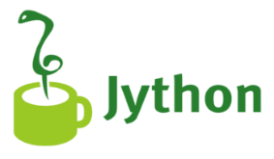
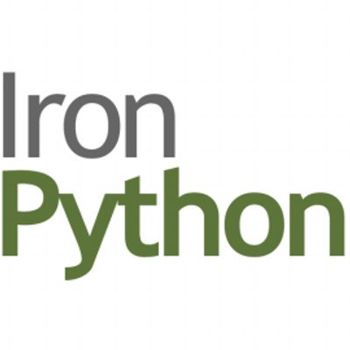
Python Types
Introduction to Programming
CPython is the original implementation of Python.
Jython is an implementation of Python designed to run on the Java platform.
IronPython is an implementation of Python that can be integrated into the .NET framework.
Notes:
Briefly explain how Python language types can be integrated in other programming languages.
Explain the following:
- CPython was written in C and Python and is defined as both an interpreter and a compiler.
- Jython can import and use any Java class.
- All types are open-source.

Slide 13
Python Installation
Introduction to Programming

Slide 14
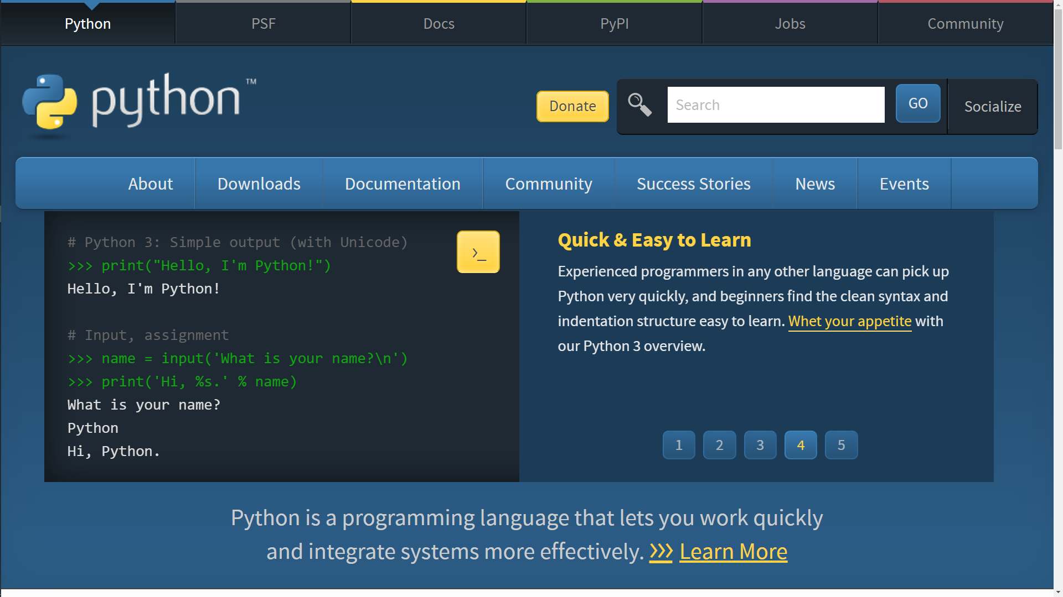
Python Website
Python Installation
Simple installation process
The website where you can download Python is Python.
Python 3 includes better support for development.
Notes:
Explain that in some cases, such as Windows, Python is not provided as part of the OS, and must be downloaded and installed.
Point out that the binaries and installation file are available at the Python website.
Explain that binaries are available for different operating systems and Python versions.

Slide 15
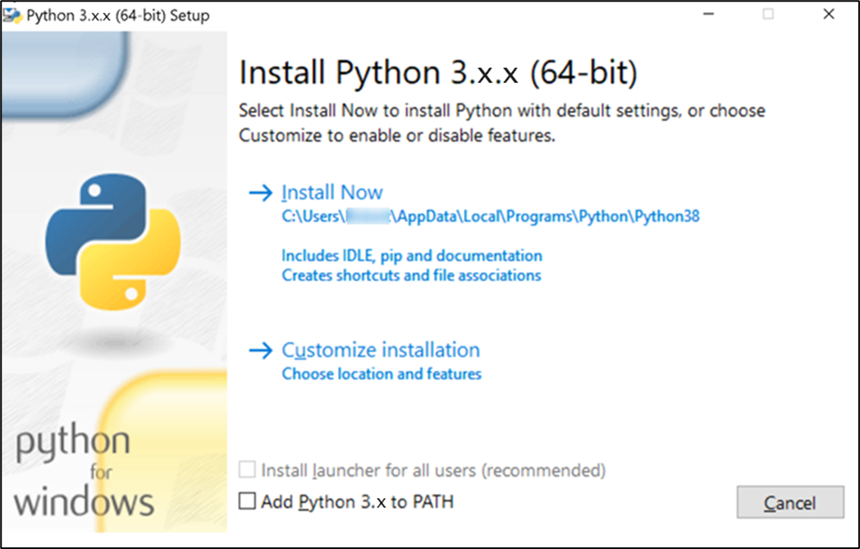
Installation Process
Python Installation
Python installation for Windows is the same as any other installation.
By default, Python 3 is installed in the AppData directory.
It is recommended to add Python to the path.
Notes:
Mention the following:
- Python installation is the same as any other program installation in Windows OS.
- Python 2 was installed in C:\, unlike Python 3.
- Without adding Python to the PATH, you will not be able to access it from the CLI.
- It is recommended to select Add Python 3.x to PATH so that it can be launched from any location, via a CLI.

Slide 16
Python in CLI
Python Installation
Microsoft Windows [Version 10.0.22000.613]
(c) Microsoft Corporation. All rights reserved.
C:\Users\John>py --version
Python 3.x.x
C:\Users\John>py
Python 3.x.x (v3.x.x, Oct 4 2021, 19:00:18) [MSC v.1929 64 bit (AMD64)] on win32
Type "help", "copyright", "credits" or "license" for more information.
>>>
Running the Python CLI interpreter in Windows is done using the CMD, by adding Python to the path.
Running either py or python3 launches the interpreter.
Notes:
Link this slide with the previous slide and demonstrate how Python can be launched from any location.

Slide 17
Python IDE
Introduction to Programming

Slide 18
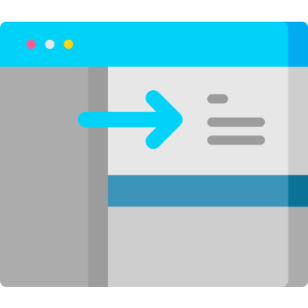
Working with IDE
Python IDE
Integrated Development Environment
A program dedicated to specific software development
IDE is easier to use than CLI.
Includes many useful tools for software development
One of the most useful IDE programs is PyCharm, which is used for Python programming.
Notes:
Briefly point out why it is better to use IDE instead of CLI.
IDE is considered easier to use and includes many functions that help the code development process.
Mention that IDE is often the preferred choice of programmers.
Mention that PyCharm is a useful IDE program used for Python programming.

Slide 19
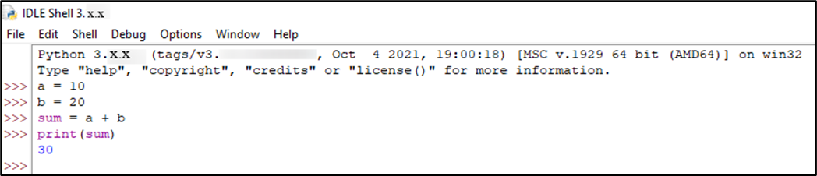
IDLE
Python IDE
Python’s Integrated Development and Learning Environment (IDLE)
IDLE has two main windows: one for Shell and the other for editing.
IDLE is a cross-platform program that works on Windows, UNIX, and macOS.
Notes:
Mention that IDLE is installed together with Python.
Explain that IDLE is used to create, modify, and execute Python scripts, or execute a single statement, similar to a Python Shell.

Slide 20
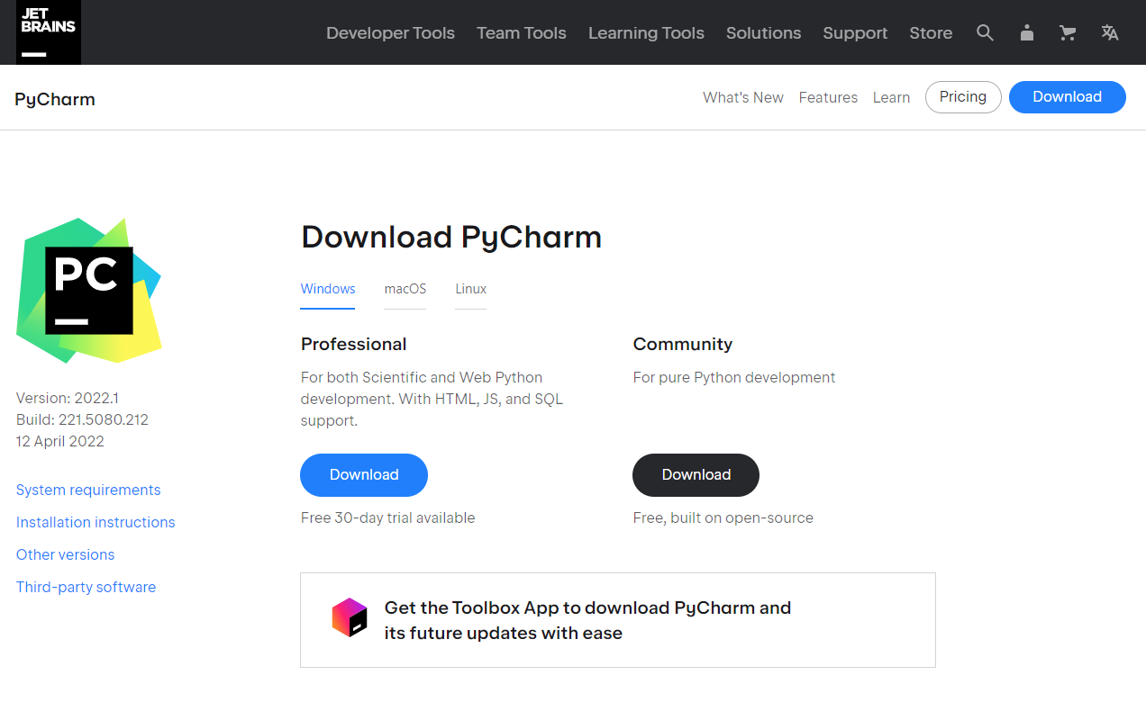
PyCharm
Python IDE
PyCharm was developed by JetBrains.
Free community version: PyCharm
Simple Windows installation, with some required configuration
Notes:
Introduce learners to PyCharm IDE and point out how it provides an overview of the code structure, suggestions about how to improve the code, and debugging capability.
Mention that although Python comes with a preinstalled IDE, more advanced IDEs are available.

Slide 21
Python Environment & PyCharm
Introduction to Programming

Slide 22
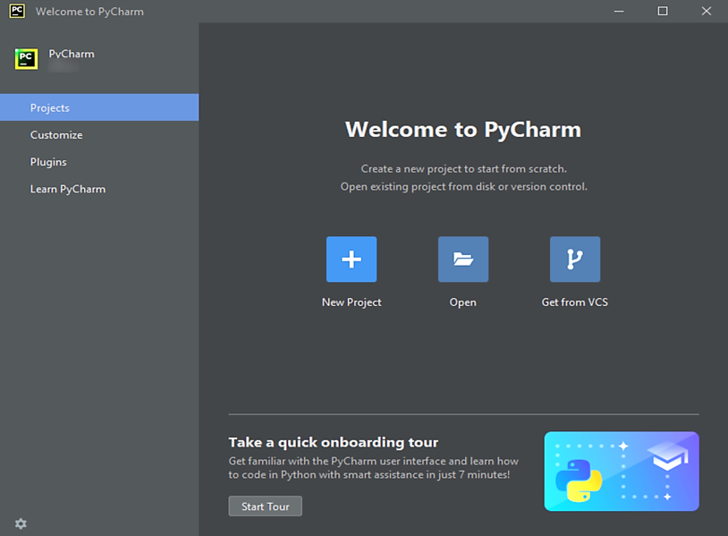
New Project
Python Environment & PyCharm
During development, treat a program like a project.
Projects help organize files and create a dedicated environment.
Projects are created using the New Project option.
Notes:
Mention that PyCharm creates a new environment for each project.
Projects are not affected by each other’s environment.

Slide 23
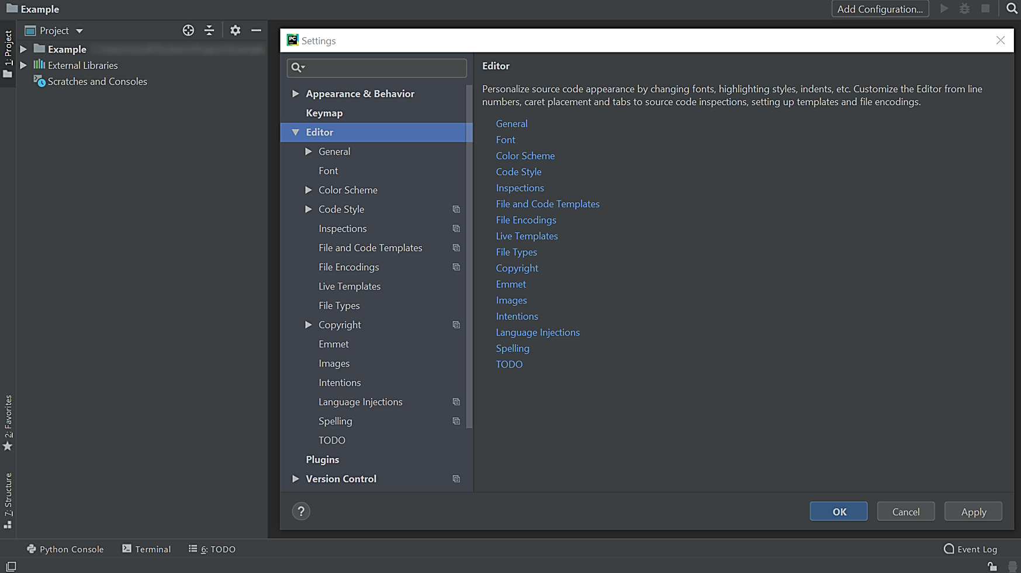
PyCharm Settings
Python Environment & PyCharm
PyCharm visual themes can be extensively configured.
Most default settings can be left as is, but some require selection.
Notes:
Describe the PyCharm Settings feature, which enables:
Changing themes, font styles, and font sizes
Interpreter configuration
Adding libraries

Slide 24
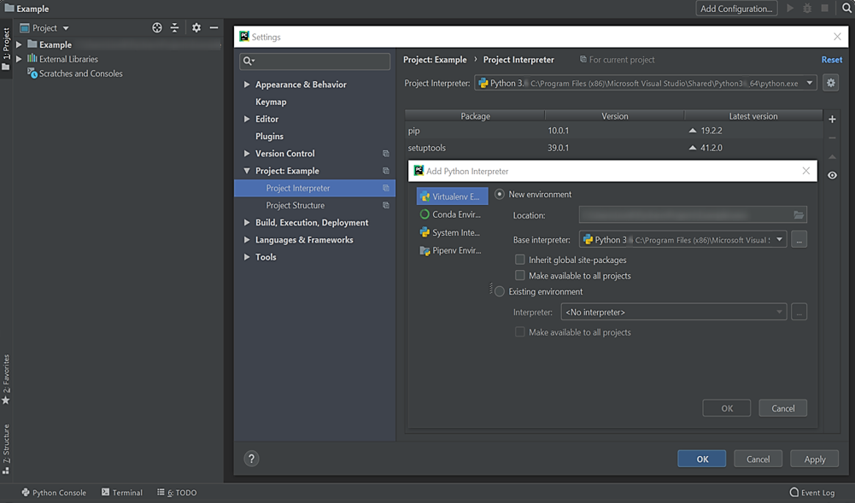
Interpreter Configuration
Python Environment & PyCharm
PyCharm allows selection of different interpreters for different projects.
Python installation should be automatically detected.
Configuration is done via Settings > Project Interpreter.
Notes:
Explain how to add an interpreter to a project in PyCharm.
Explain that if the PyCharm installation is not detected, it can be added manually.

Slide 25
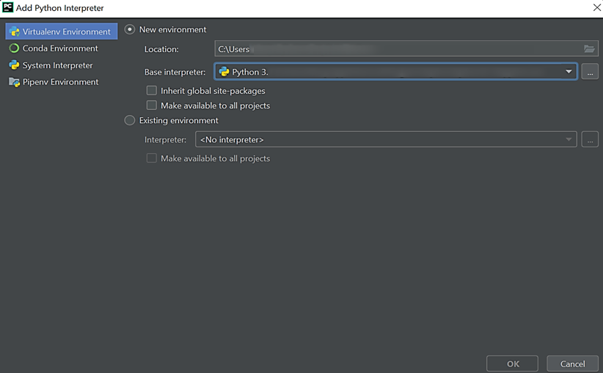
PyCharm Virtual Environment
Python Environment & PyCharm
PyCharm allows virtual environment tools to create isolated projects.
The purpose of a virtual environment is to manage all project settings.
Virtual environment creation is relatively easy.
Notes:
Explain why it is preferable for Python to work with an interpreter rather than a compiler.
By using an interpreter, projects will run in a virtual environment with the selected Python version and cannot be downgraded to earlier versions, which would ruin the entire project.
Explain the advantage of working with a virtual environment so that projects will not be affected by each other’s environment.
Show how to add a Python interpreter: Select Add Python Interpreter and click Add Interpreter.

Slide 26
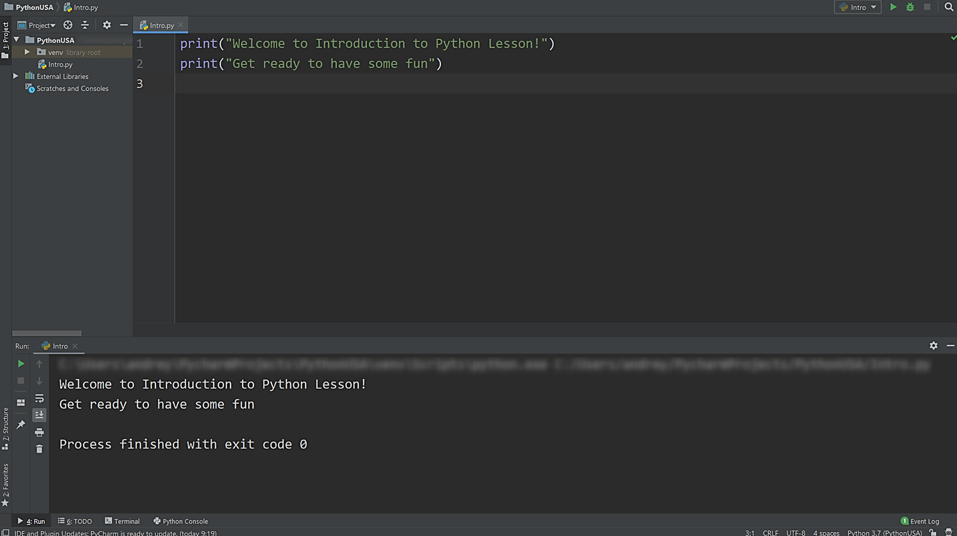
PyCharm Code Execution
Python Environment & PyCharm
PyCharm has several ways to execute code.
After execution, the console will appear with the results and errors.
The console informs the developer if there are mistakes in the code.
Notes:
Explain how a project’s code can be executed using various methods, such as right-click -> Play, Shift+F10, or clicking the Play icon at the top right.
Explain that the console inspects the syntax and provides the results.

Slide 27
Lab PY-01-L1
Python Environment & PyCharm
Install Python and PyCharm Community Edition on your Windows system.
Installing Python
15–20 Min.
Download and install Python 3.
Download and install PyCharm Community Edition from JetBrains.
Browser
Python 3
PyCharm
Lab document

Slide 28
Basic Syntax
Introduction to Programming

Slide 29
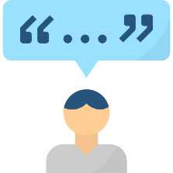
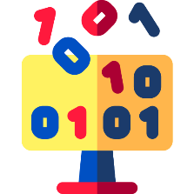
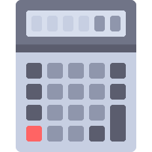

Python Data Types
Basic Syntax
String
Integer
Float
Boolean
Notes:
Explain each data type and how float differs from integer.
Point out the following:
When declaring a string, the value should be included in quotation marks.
Integer values can be positive or negative integer numbers.
Float values can be positive or negative decimal numbers.
Boolean values (0, 1) are used in logical operations and decision trees.

Slide 30

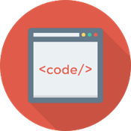

Python Syntax
Basic Syntax
Hashtag (#) renders an entire line as a comment.
#This is a comment
print("Hello World!")
#prints Hello World!
"""
This is how
a multi-line string
Comment looks.
"""
Three quotation marks (""") are used in the beginning and end of multi-line comments.
Three quotation marks can be used in print() to print multi-line strings.
Notes:
Explain that comments are used to convey information that is not part of the code.
Explain the importance of using comments in programs and scripts to make the code more comprehensible.
Describe Docstrings and mention that they are used when the length of a string exceeds more than one line.
Point out that three quotation marks are placed on the line above the comment and on the line at the end of the comment.

Slide 31



Standard Syntax Principles
Basic Syntax
Most programing languages are case-sensitive.
number = 1
number = number + 5
#add 5 to number
print("Hello World!")
#prints Hello World!
Statements must be fully written.
Case-sensitive means that x is not the same as X, and John is not john.
Notes:
Explain the following:
- The case of a character does not depend on its location in a statement.
- Case-sensitive and case-insensitive languages (provide examples)
- Python is a case-sensitive programming language.
- Some languages require a symbol to end a statement, such as a semicolon (;).
- Case-sensitive means that x is considered different than X.

Slide 32



Code Handling
Basic Syntax
Whitespace: Invisible characters that make the code more readable
def main():
print("Main function")
print("Second line")
main()
class = 5
#this variable name cannot be used and will trigger an error
Keywords: Python’s reserved words and instructions
Indentation: A mechanism that associates a block of code with a condition, loop, or class
Notes:
Explain the following:
- Python is a more readable language due to its use of whitespace and indentation.
- Code blocks can be determined based on whitespace.
- Keywords cannot be used as variable names.
- Most languages ignore extra spaces or lines as long as they can recognize the different elements.
- Some languages recognize indentation.
- Give examples of reserved keywords that cannot be used as variable names.
- Give examples of these keywords: and, if, class, finally, print, return, raise.

Slide 33
Lab PY-01-L2
Basic Syntax
Use Python to build a program that will print a string to the console.
Comments and Print
10–15 Min.
Print messages.
Use comments.
Windows
Python 3
PyCharm
Lab document

Slide 34
Lab PY-01-L3
Basic Syntax
Customize your PyCharm environment.
PyCharm Personalization
10–15 Min.
Change the PyCharm look.
Windows
Python 3
PyCharm
Lab document

Slide 35
TDX Arena Lab Homework
Programming Fundamentals
Use TDX Arena for additional practice working with variables and data types.
Sign in to the TDX Arena platform.
Navigate to the Practice Arena.
Navigate to the Python Programming course.
Select PY01 Programming Fundamentals.
Select the Variables and Data Types lab.
Complete the homework before the next class.
Complete any labs or challenges you did not finish in class.
Variables and Data Types
Notes:
Learners will need to navigate to the appropriate TDX Arena practice arena as described on the slide.

Slide 36
Questions?
Thank You

